Slide 1

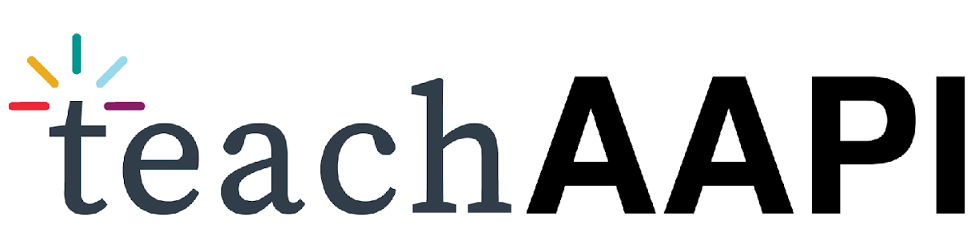
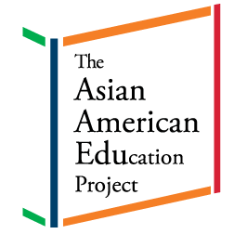
AAPI in U.S. History:
The First Lunar New Year Celebration
in the United States
Notes:
Extension Activities: TAP Kindergarten Extension Activities: Lunar New Year

Slide 2
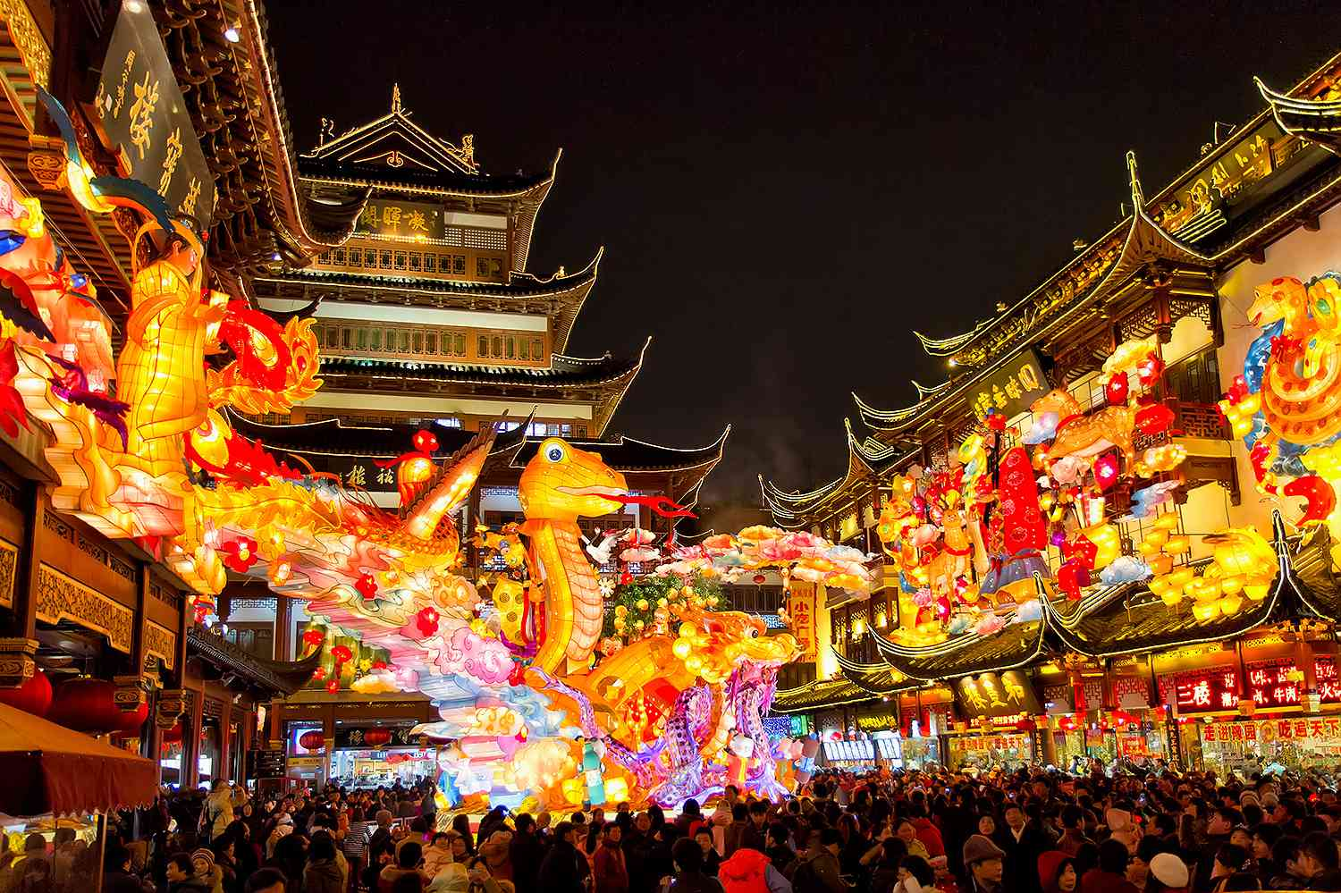
Lunar New Year
Lunar New Year is a big celebration. It is celebrated all over the world.
Image: Lunar New Year celebration | Getty Images
Notes:
LESSON:

Slide 3
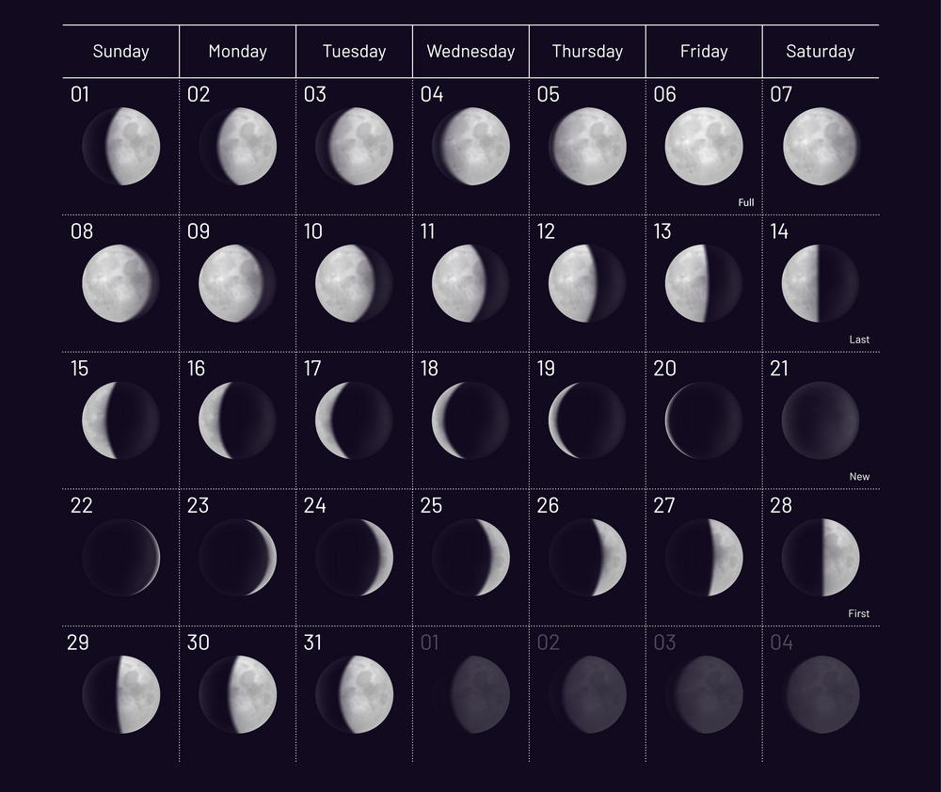
Lunar New Year Calendar
It takes place in January or February. It’s based on the lunar calendar. So the date changes every year.
Image: 2023 Moon phases | vectorstock.com
Notes:
LESSON:

Slide 4
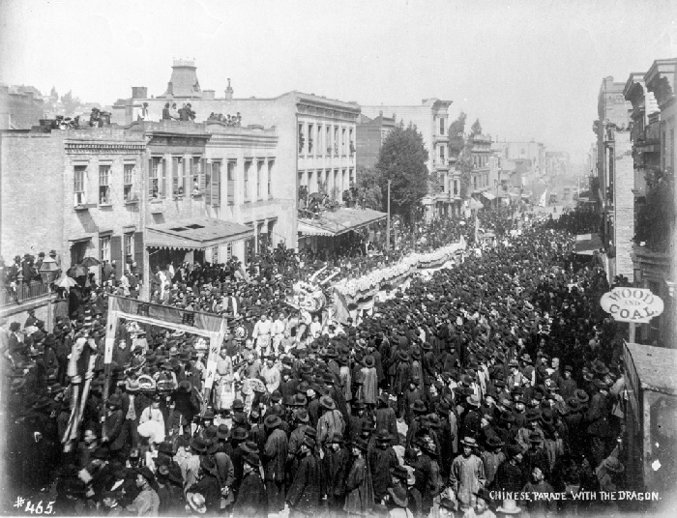
First Lunar New Year Celebrations in the U.S.
The first U.S. Lunar New Year celebrations took place in San Francisco, California.
Image: Chinese parade with dragon | Marilyn Blaisdell Collection
Notes:
LESSON:

Slide 5
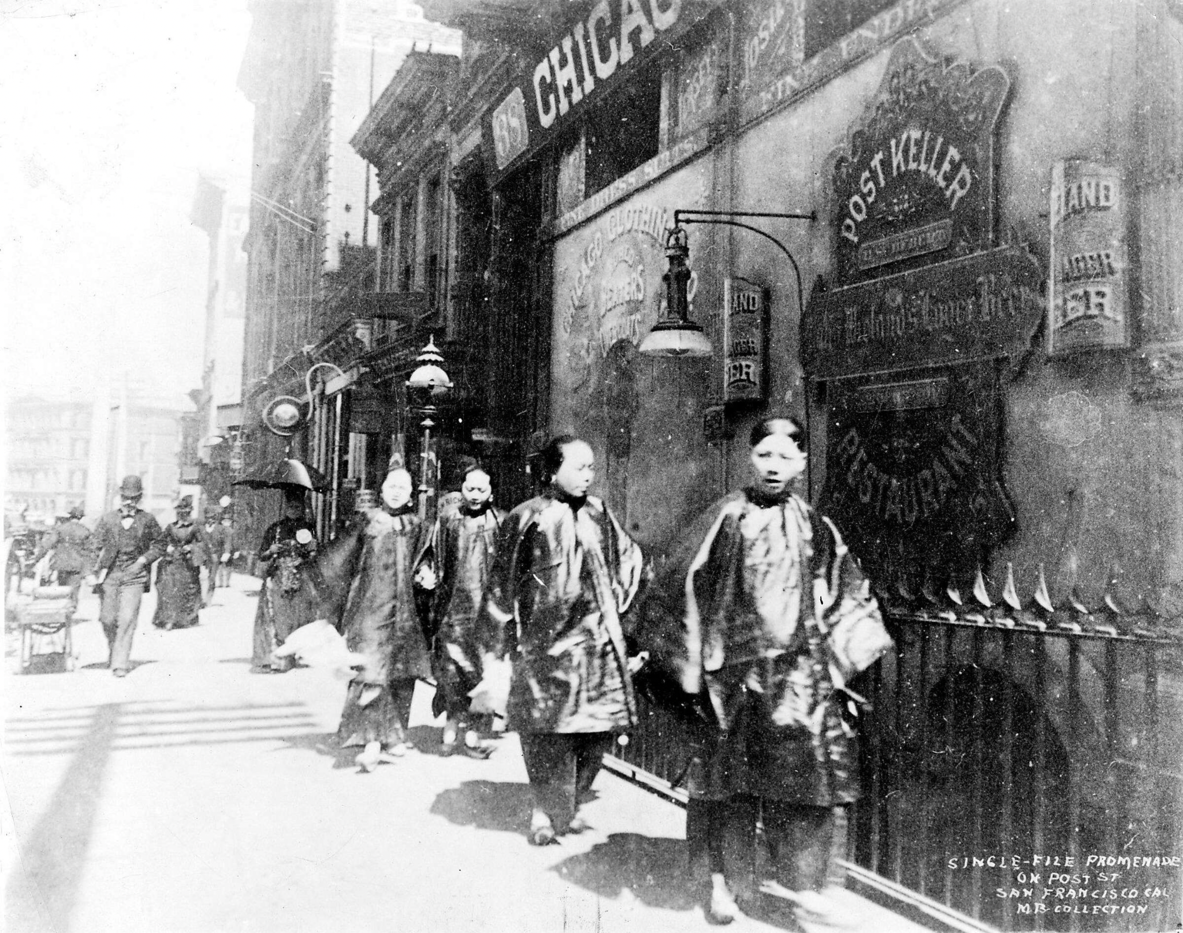
First Lunar New Year Celebrations in the U.S.
Early Lunar New Year celebrations started in the 1850s. These celebrations were small.
Image: Chinese men gathering in Chinatown, San Francisco, CA 1850-60s (SF Chronicles)
Notes:
LESSON:

Slide 6
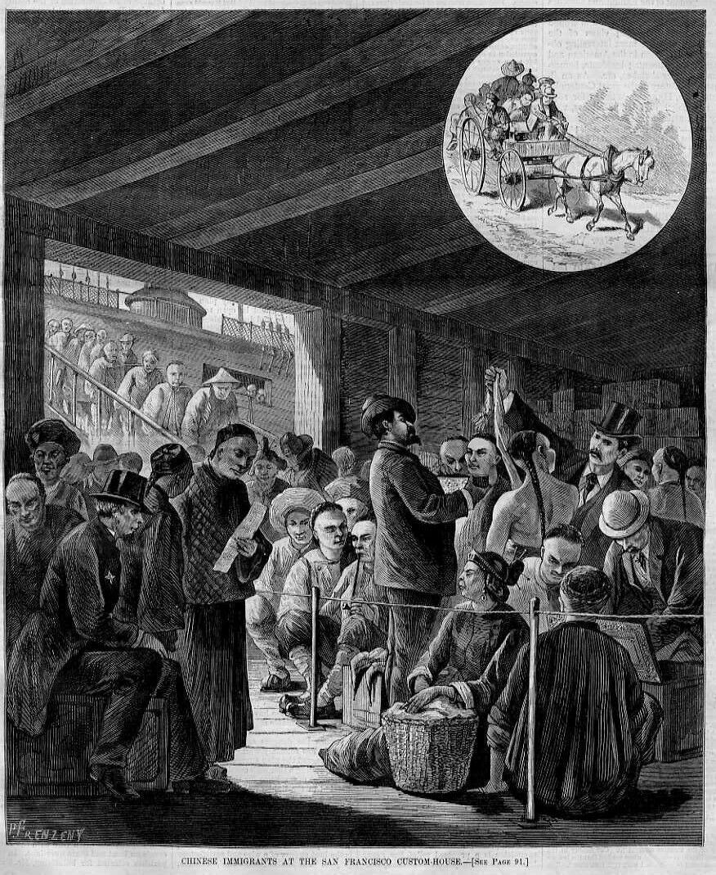
First Lunar New Year Celebrations in the U.S.
They were done in secret. This is because Chinese immigrants were unwelcomed. They were treated badly.
Image: Chinese immigrants at the San Francisco custom-house | Harper’s Weekly; Library of Congress
Notes:
LESSON:

Slide 7
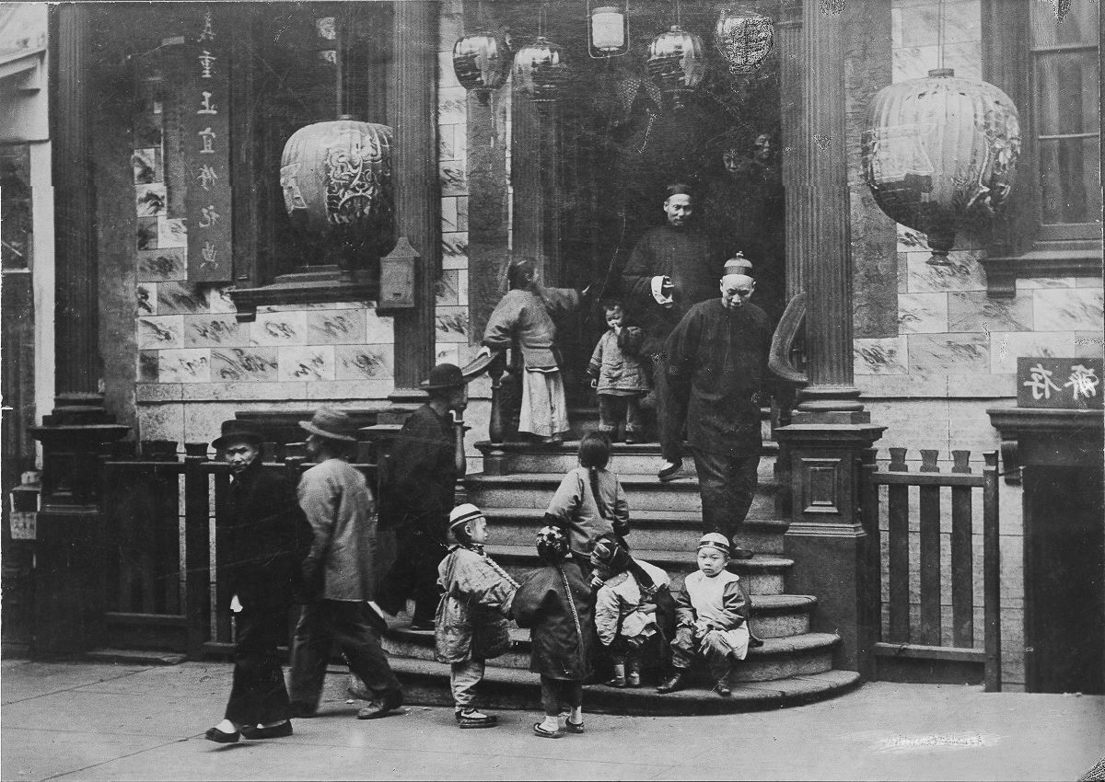

First Lunar New Year Celebrations in the U.S.
But, they were proud of their culture. They wanted to celebrate.
Image: Chinese immigrants dressed in traditional Chinese clothes, San Francisco, CA (chroniclingamerica.loc.gov)
Notes:
LESSON:

Slide 8
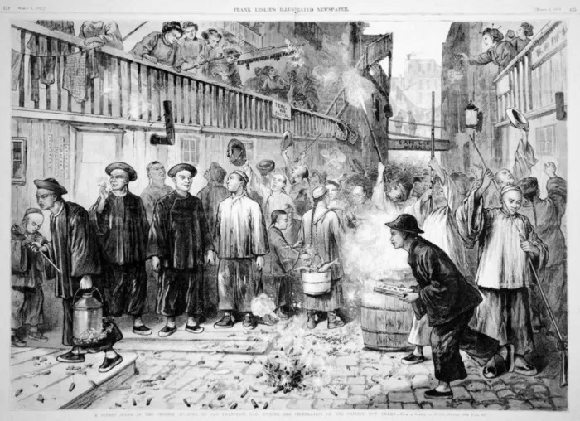
First Lunar New Year Celebrations in the U.S.
The first public Lunar New Year celebration was in 1860. The Chinese American community in San Francisco hosted it.
Image: Chinese New Year in San Francisco | University of California
Notes:
LESSON:

Slide 9
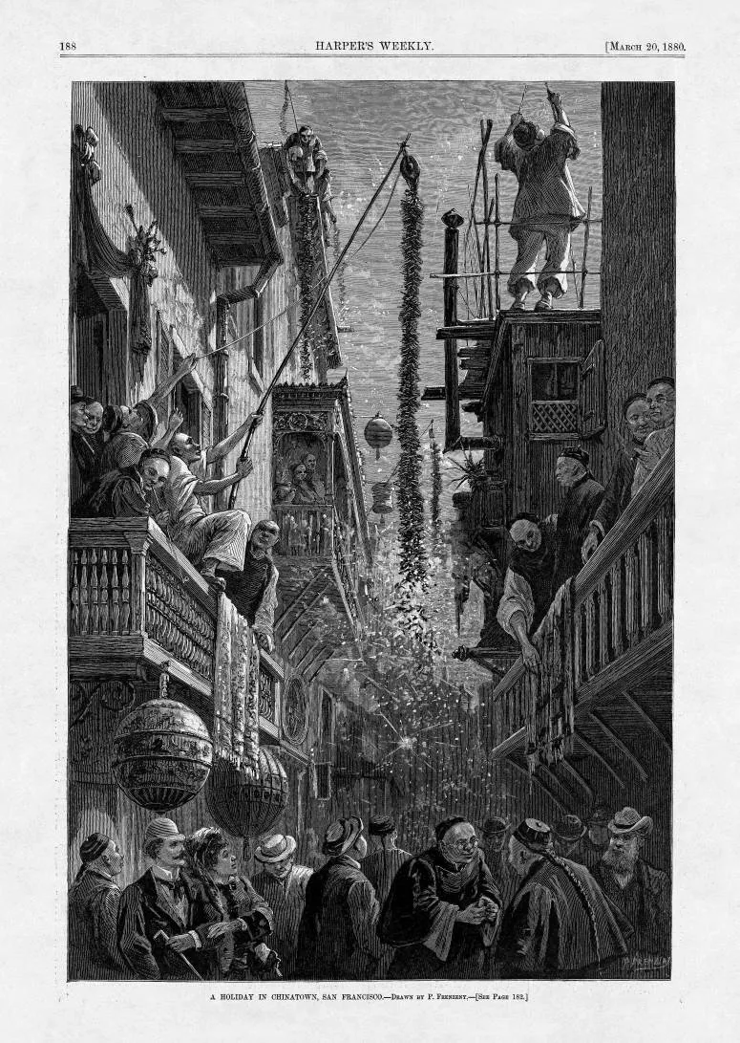
Early Lunar New Year Traditions
They combined their Chinese traditions with American ways. They hosted a festival. They hosted a parade.
Image: Woodcarving of New Year’s in San Francisco’s Chinatown | Harper’s Weekly
Notes:
LESSON:

Slide 10
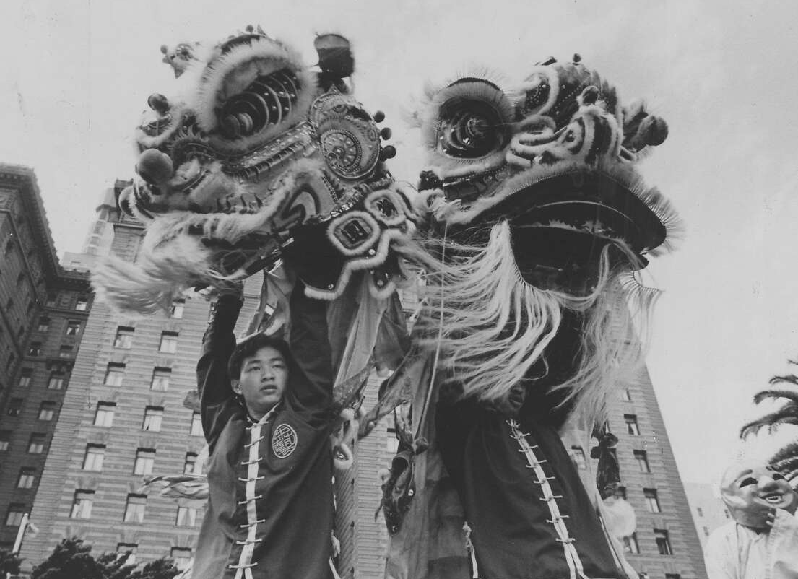
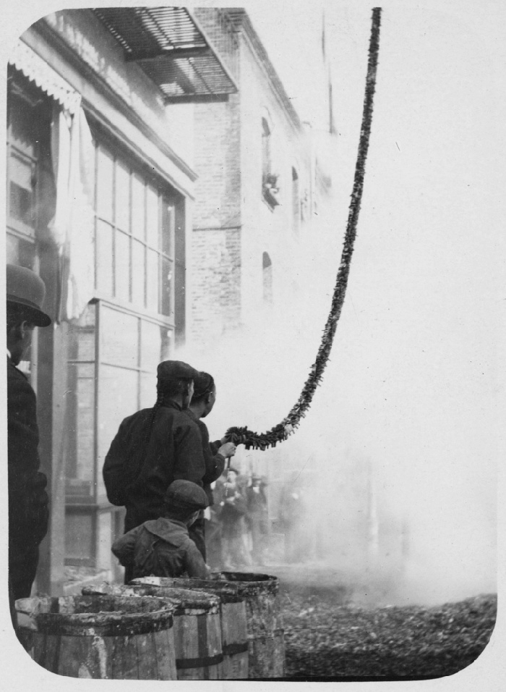
Early Lunar New Year Traditions
There was lion dancing for good luck and fortune. There were firecrackers to scare away evil spirits.
Image: San Francisco Chinese New Year Parade, Feb. 1, 1987 | SF Chronicle archives
Image: Men setting off string of firecrackers for Chinese New Year in Chinatown | OpenSFHistory.org
Notes:
LESSON:

Slide 11
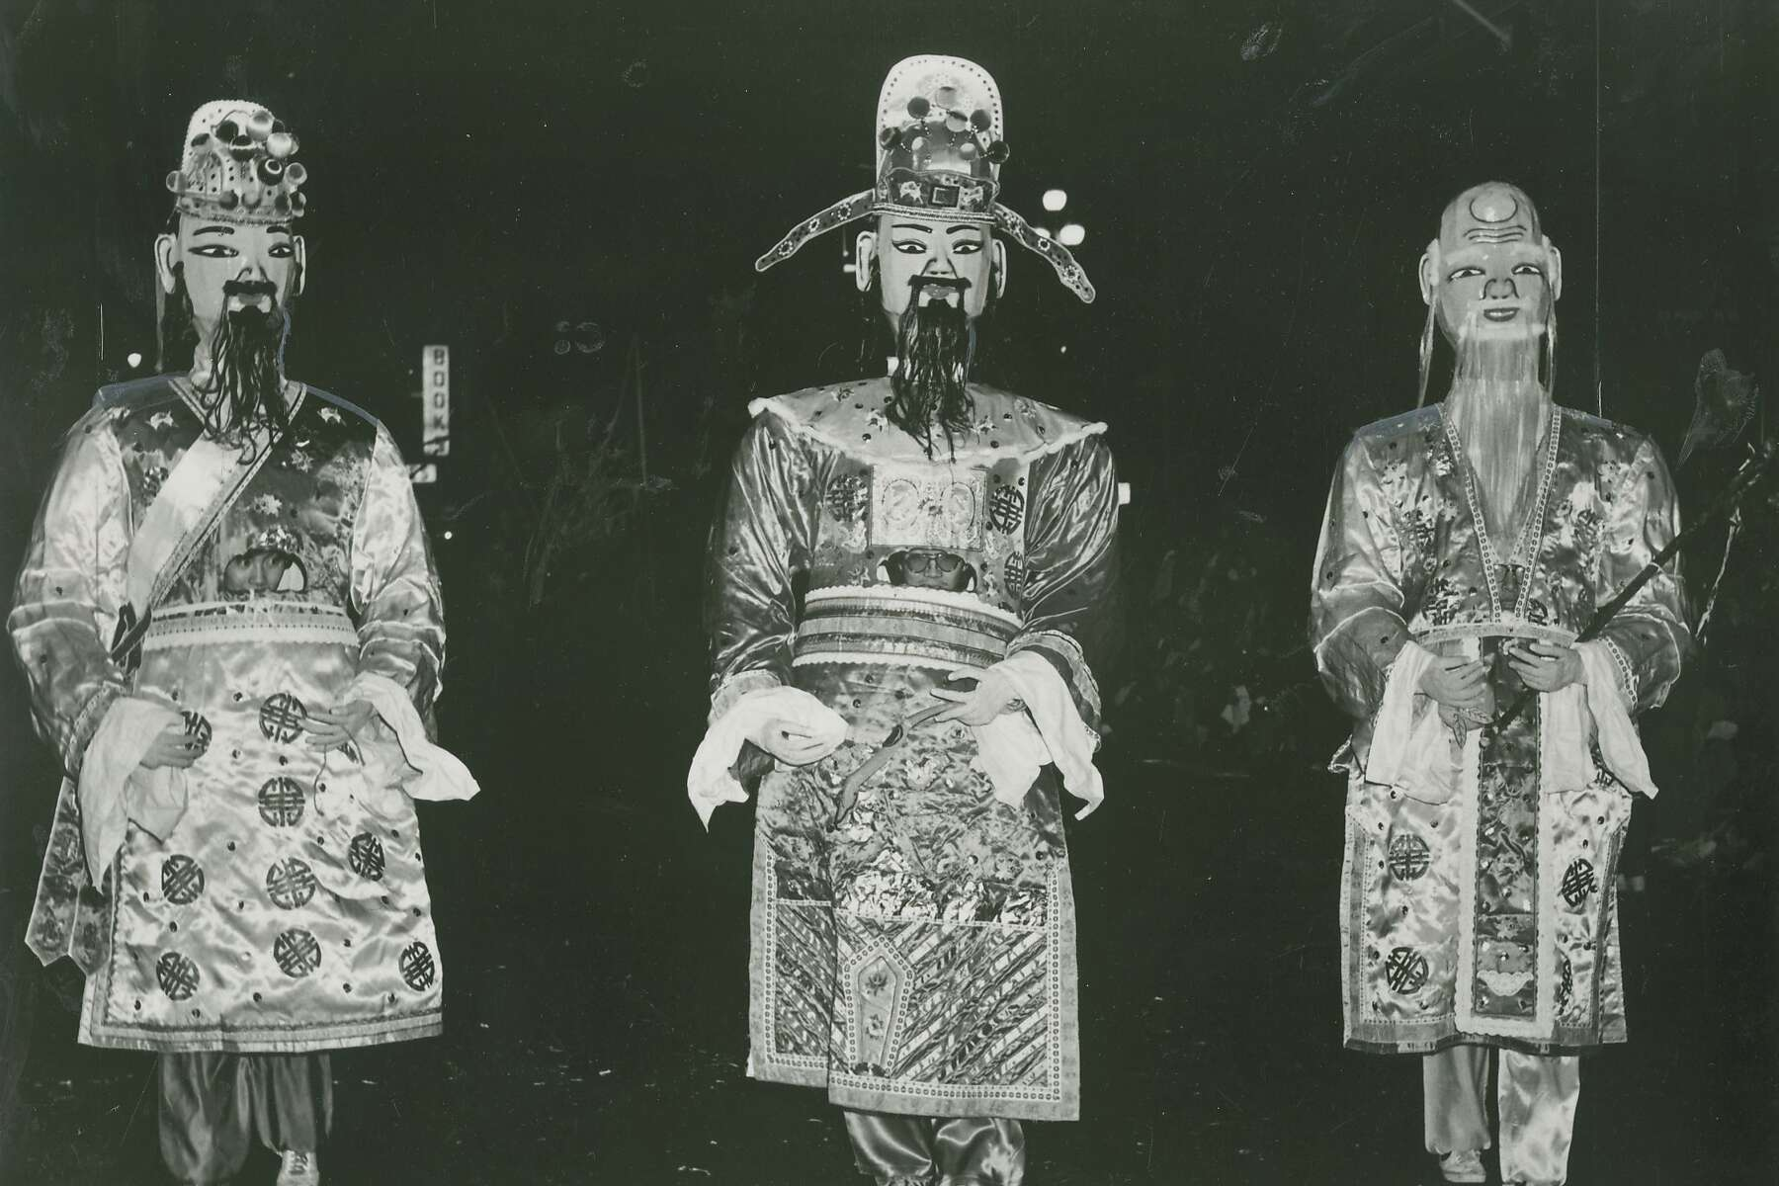
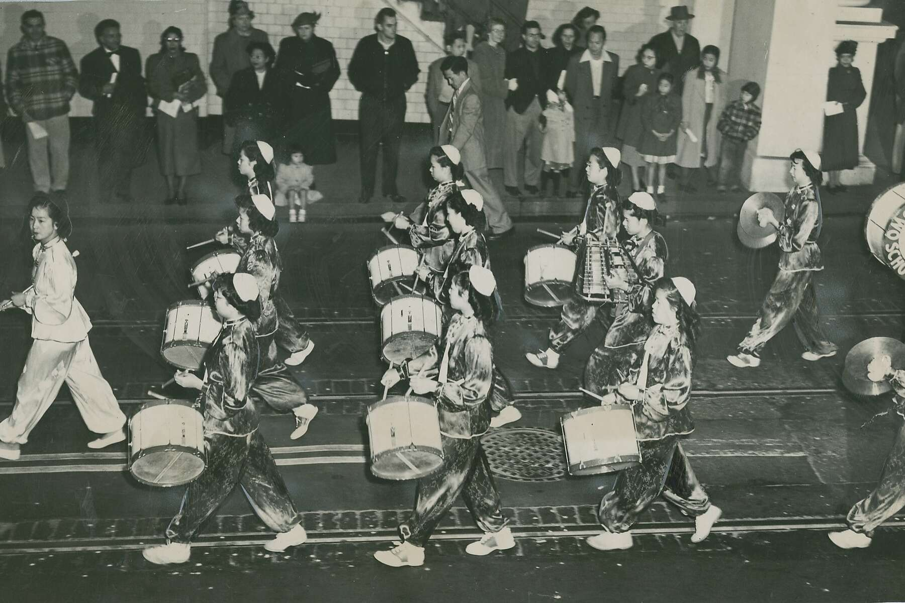
Early Lunar New Year Traditions
Over time, more fun things were added. There was art. There were dances.
Image: “Eight Immortals” puppets for San Francisco Chinese New Year Parade (San Francisco Chronicles)
Image: Chinatown’s Hip Wo School band during Chinese New Year Parade (San Francisco Chronicles)
Notes:
LESSON:

Slide 12
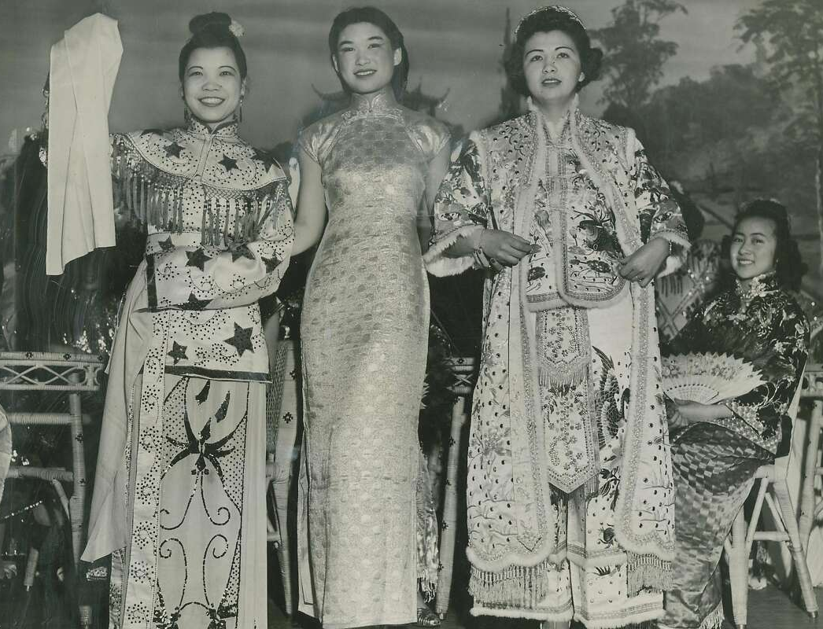
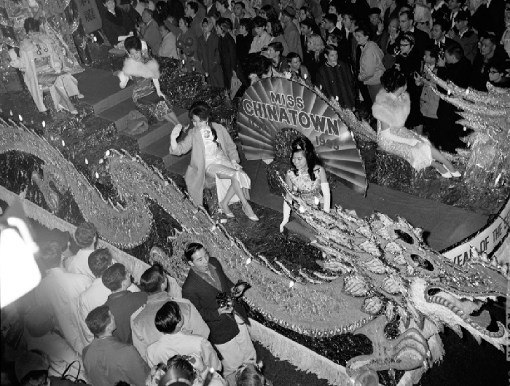
Early Lunar New Year Traditions
There were fashion shows
There was a Miss Chinatown contest
Image: Fashions on Parade, San Francisco Chinese New Year | SF Gate Chronicle archives
Image: Miss Chinatown float, Feb. 1963 | OpenSFHistory.org
Notes:
LESSON:

Slide 13
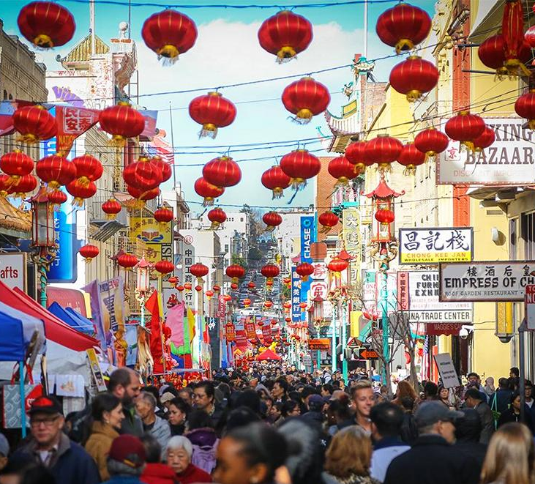
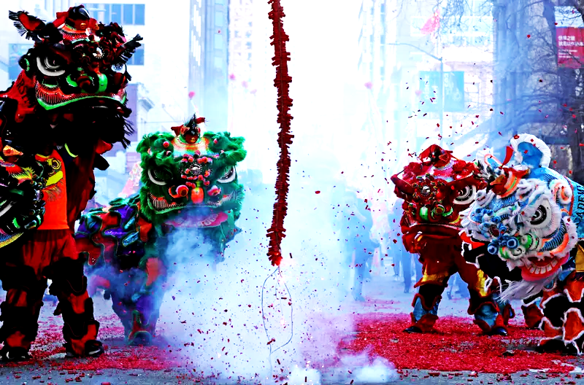
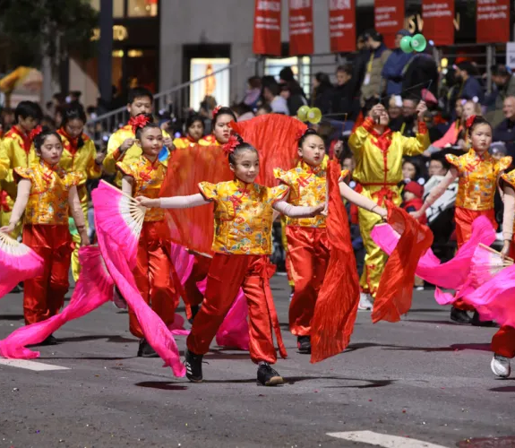
Lunar New Year Celebrations Today
Today, the Chinese New Year Festival and Parade in San Francisco is the biggest Lunar New Year Celebration in North America.
Image: Chinese New Year festival and parade, San Francisco (Alaska Airlines)
Image: Lions dance around firecrackers (Justin Sullivan/Getty Images)
Image: Chinese New Year dancers in San Francisco (chineseparade.com)
Notes:
LESSON:

Slide 14
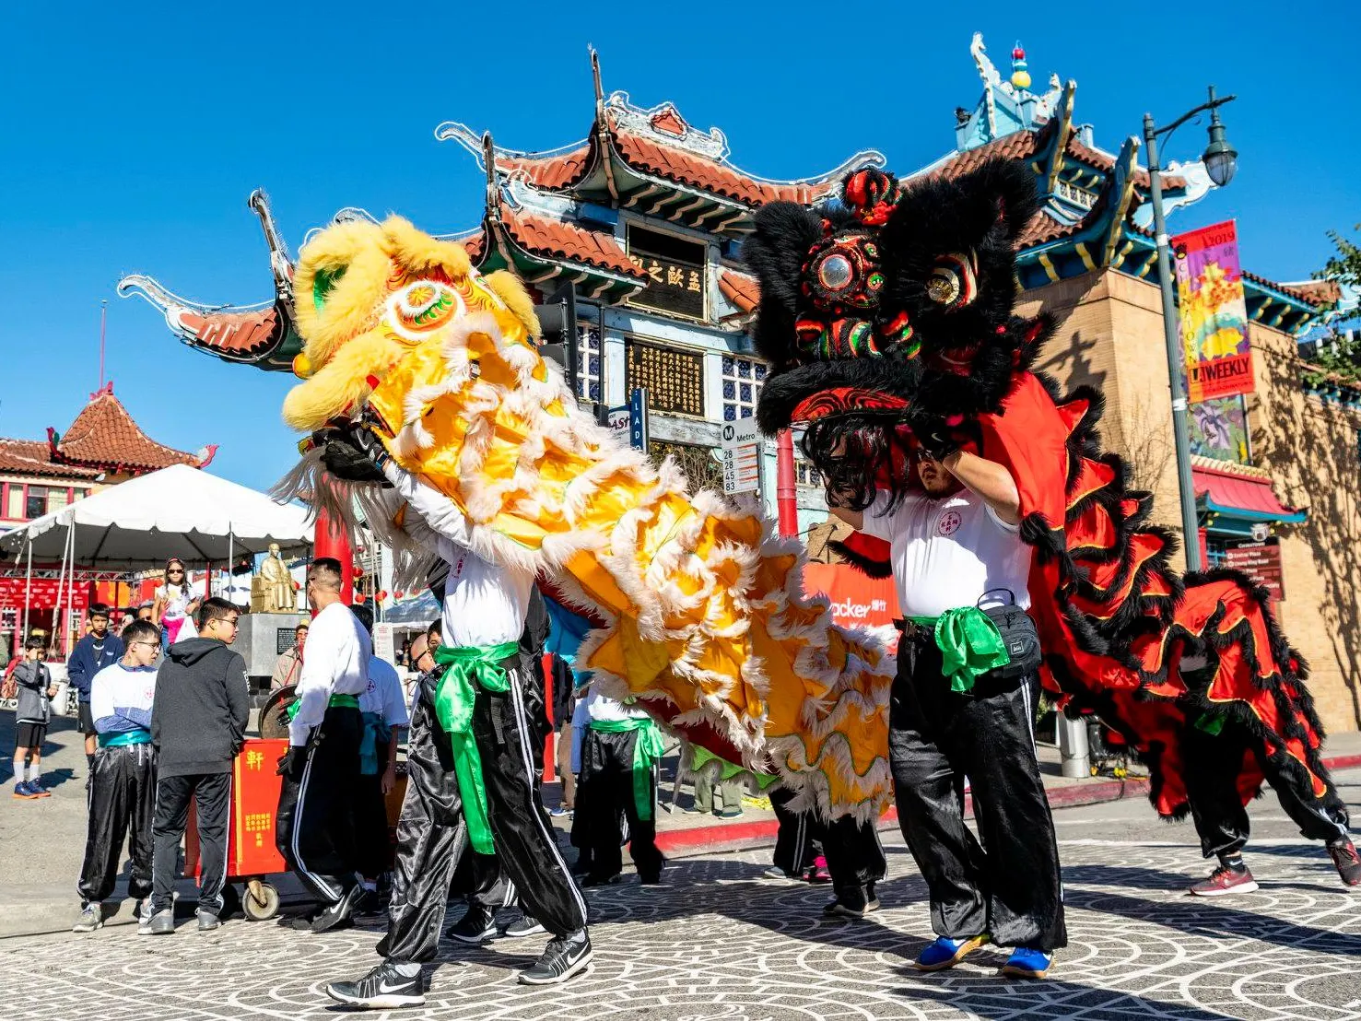
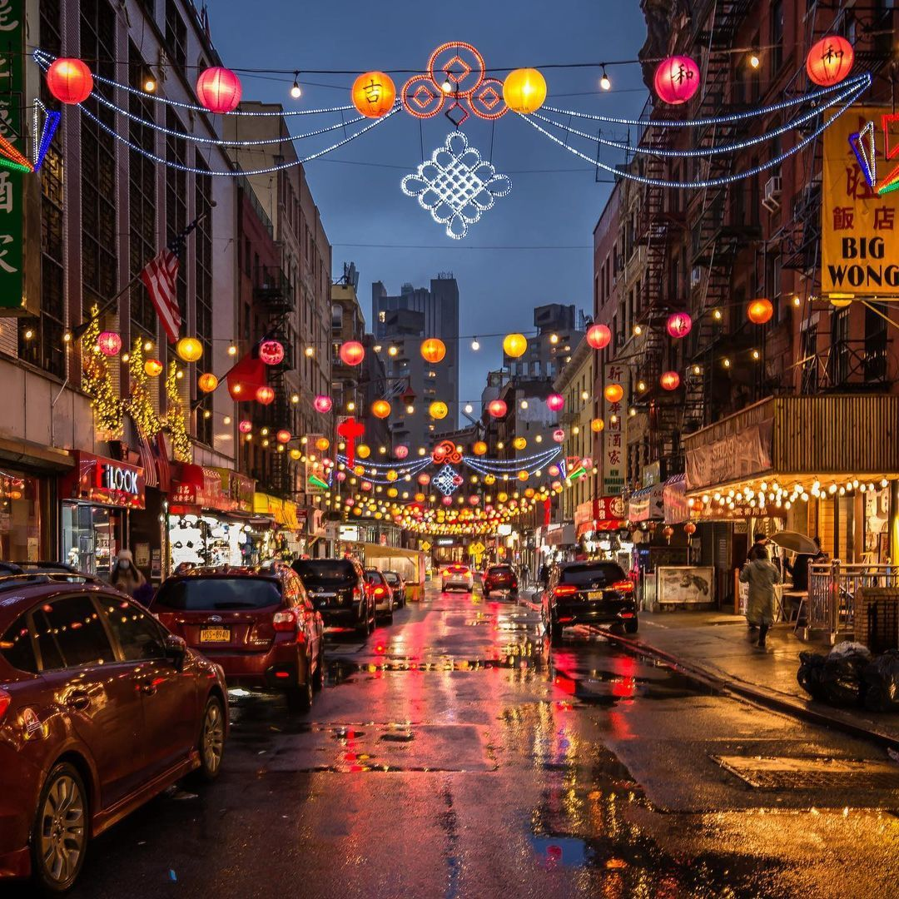
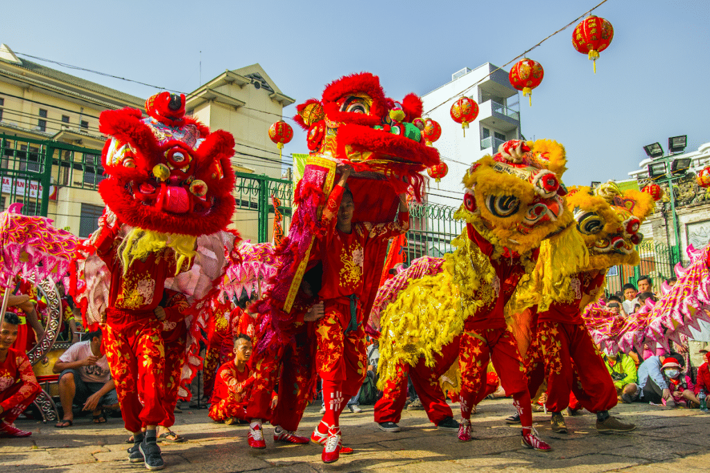
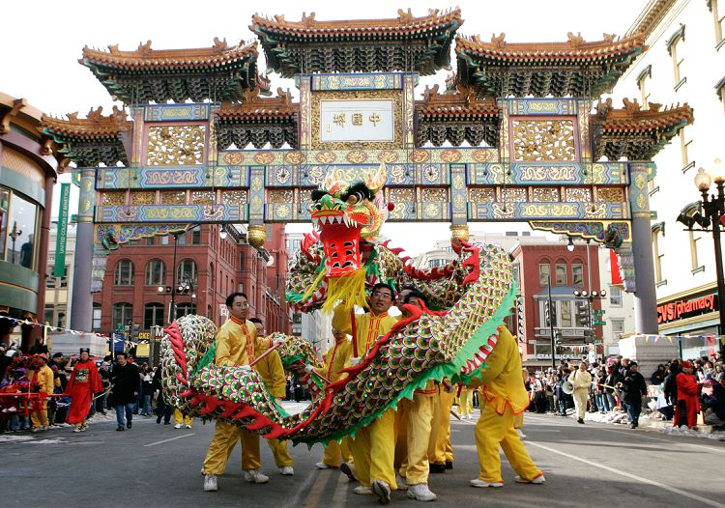
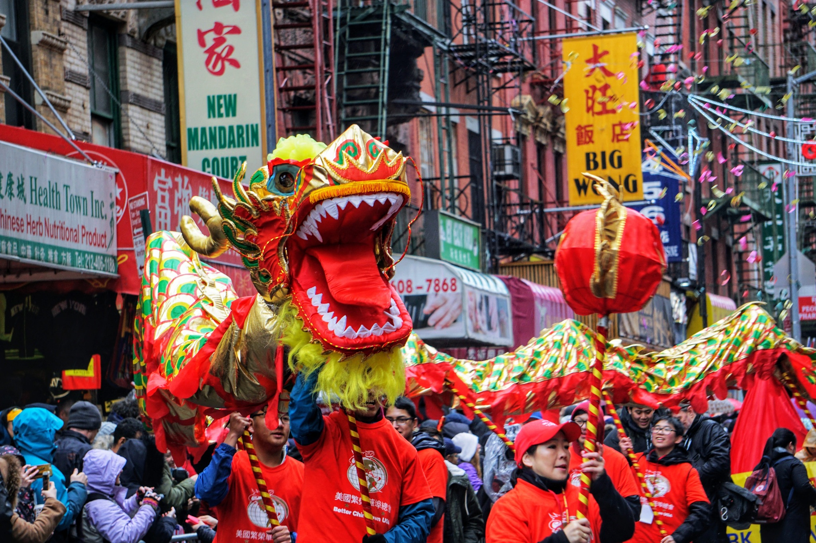
Lunar New Year Celebrations Today
Lunar New Year is also celebrated in cities big and small, wherever there are Chinese in the community. These celebrations help preserve tradition.
Image: Lion Dance, Chinatown, LA (DiscoverLA.com)
Image: Lunar New Year parade, NYC (gothamtogo.com)
Image: Lunar New Year parade, Huston (posthtx)
Image: Lunar New Year, D.C. (Alex Wong/Getty Images)
Los Angeles, CA
New York, NY
Houston, TX
Washington, D.C.
Notes:
LESSON:
Some schools celebrate Lunar New Year to share the celebration with everyone at school

Slide 15

Vocabulary
Celebration: a special event or day with festivities
Community: a group of people that have things in common, like interest or where they live
Festival: a special day or period with its own activities, food, or ceremonies
Firecracker: a usually paper cylinder containing an explosive and a fuse and set off to make a noise

Slide 16
Vocabulary
Immigrant: a person who comes to a country to stay there permanently
Lunar calendar: a dating system based on the moon cycle
Parade: a public procession usually to mark a holiday or event
Public: open to general view
Tradition: the handing down of information, beliefs, or customs

Slide 17
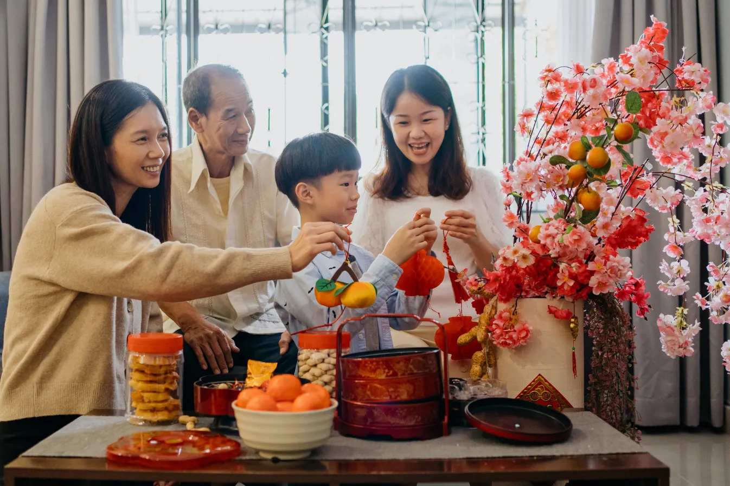
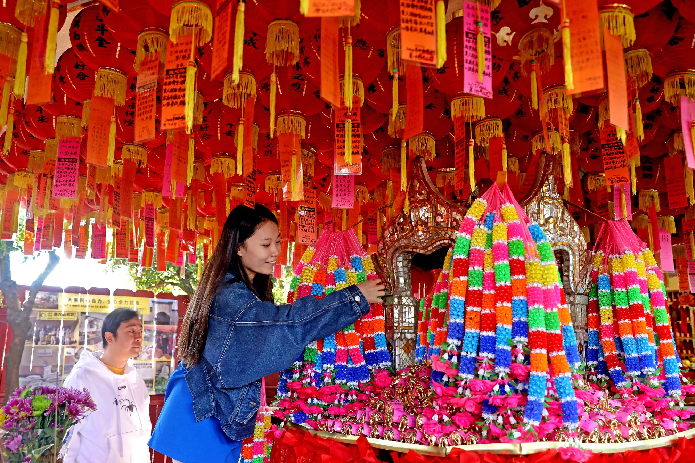
Vocabulary
Celebration: a special event or day with festivities
Image: Family celebrating Lunar New Year (Hxyume/Getty Images)
Image: Couple makes an offering at the four-faced Buddha shrine (Gary Coronado/L.A. Times)

Slide 18
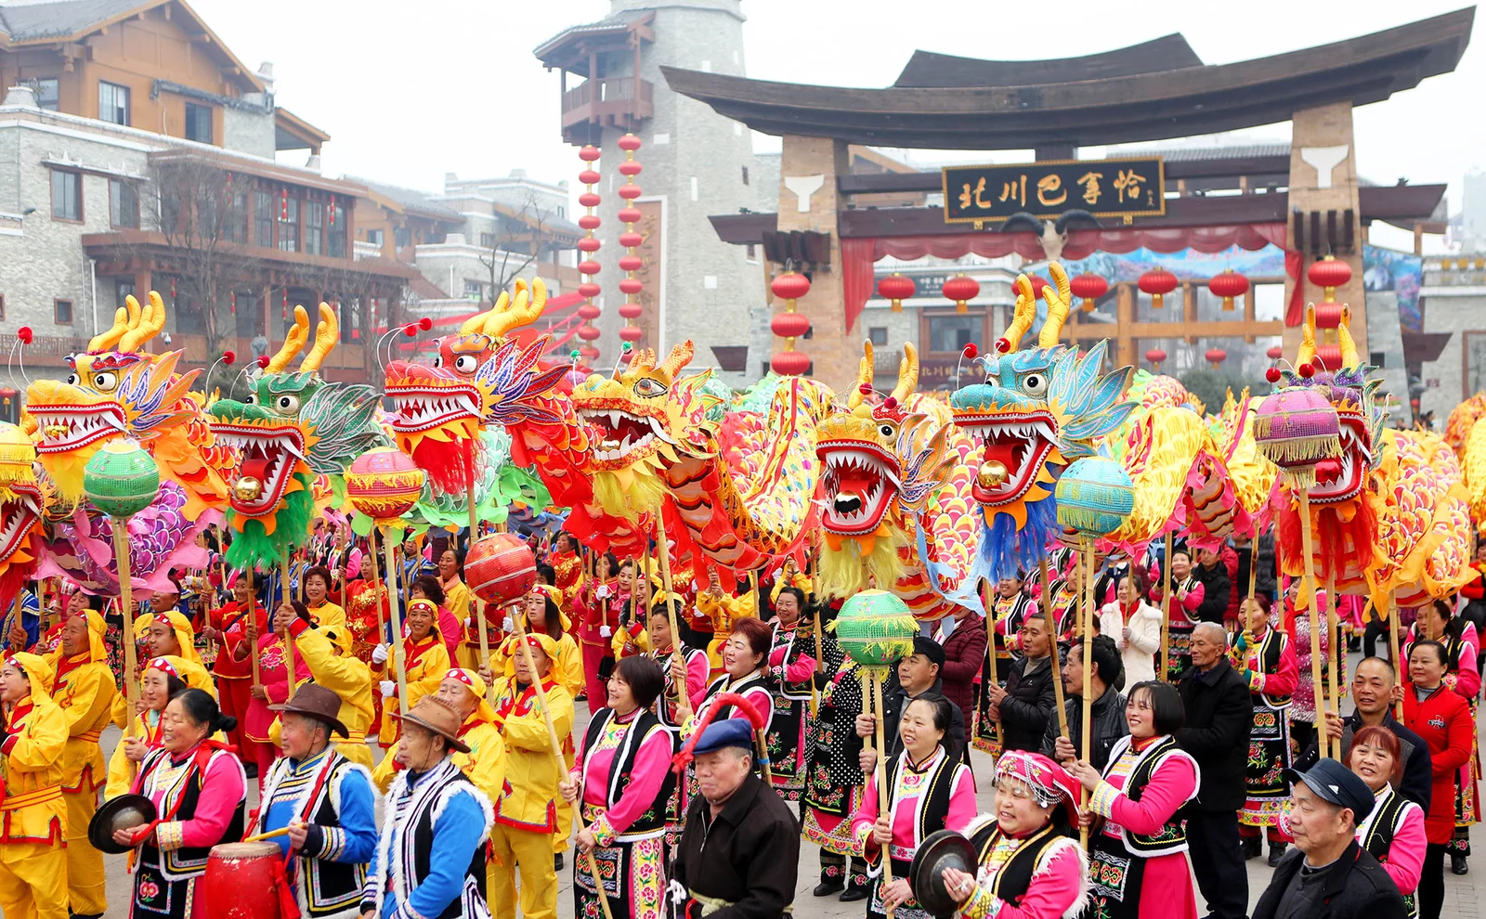
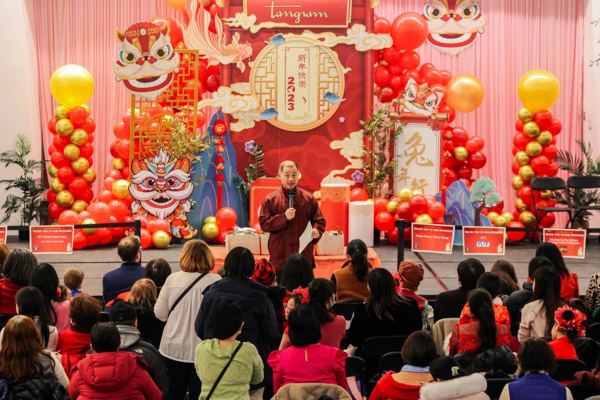
Vocabulary
Community: a group of people that have things in common, like interest or where they live
Image: Residents of Mianyang, China celebrating Lunar New Year (VCG/Getty Images)
Image: Musical and cultural performances for Lunar New Year (G. Adrian Childress)

Slide 19
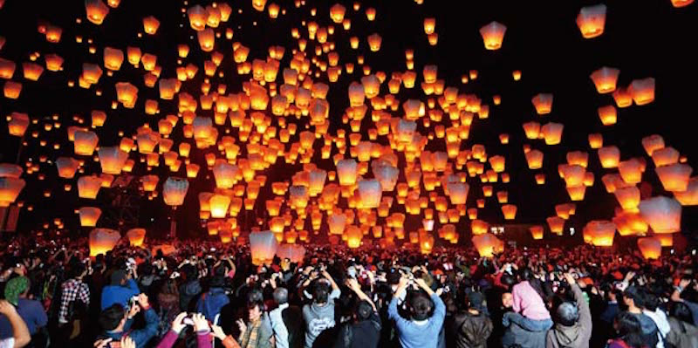
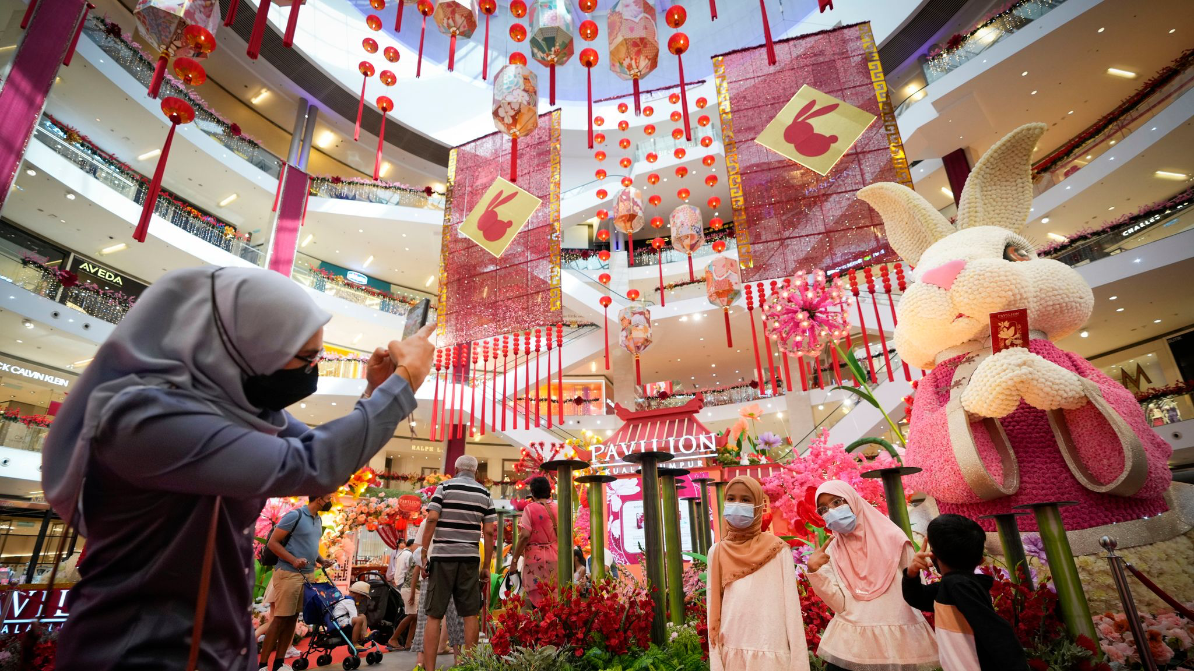
Vocabulary
Festival: a special day or period with its own activities, food, or ceremonies
Image: Lunar New Year lantern lighting (Associated Press) )
Image: Lunar New Year decorations put up in Kuala Lumpur shopping mall (Associated Press)

Slide 20
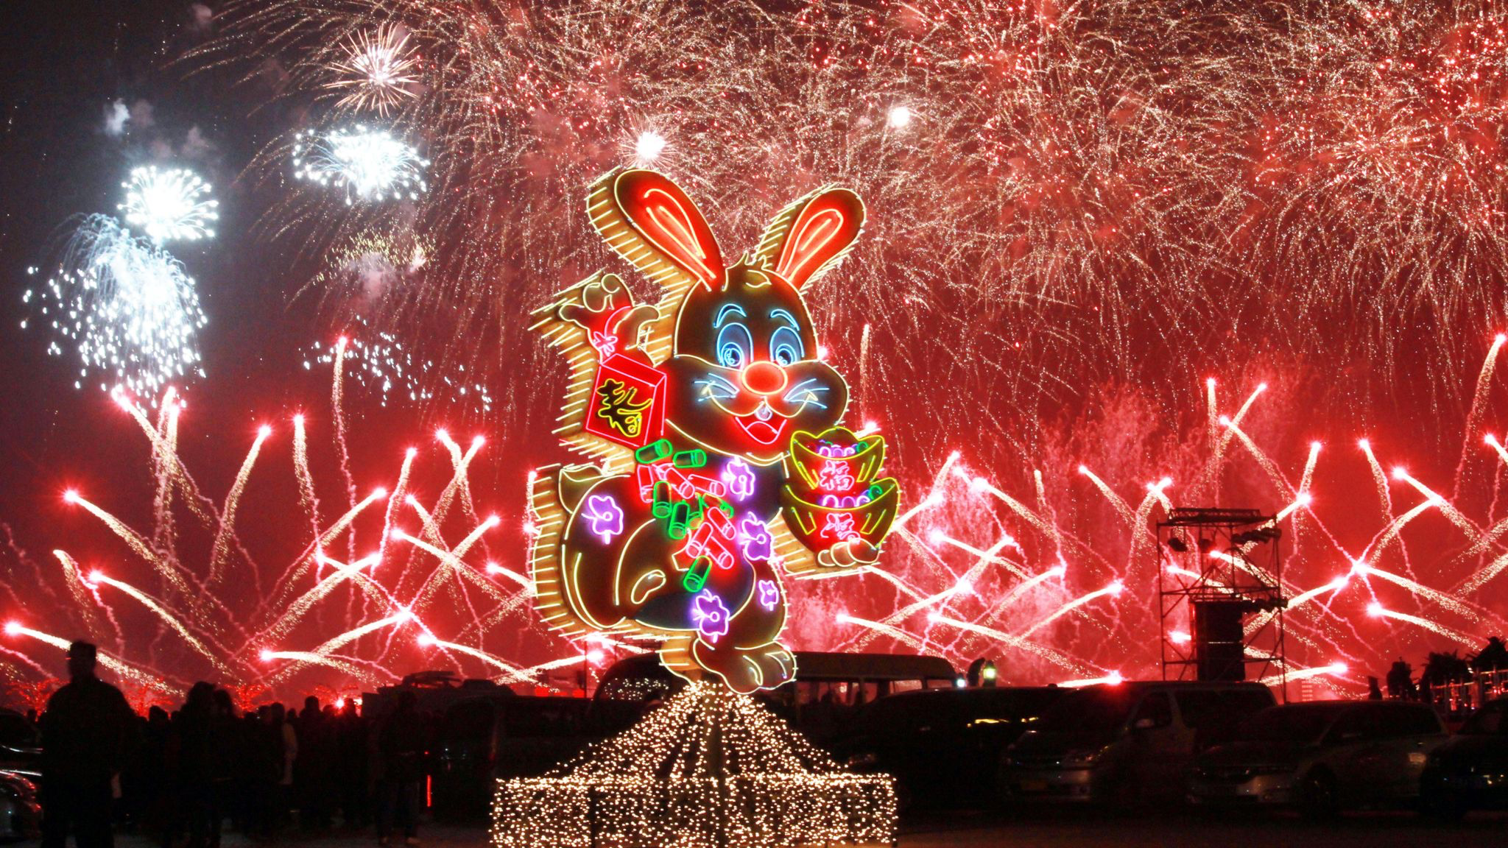
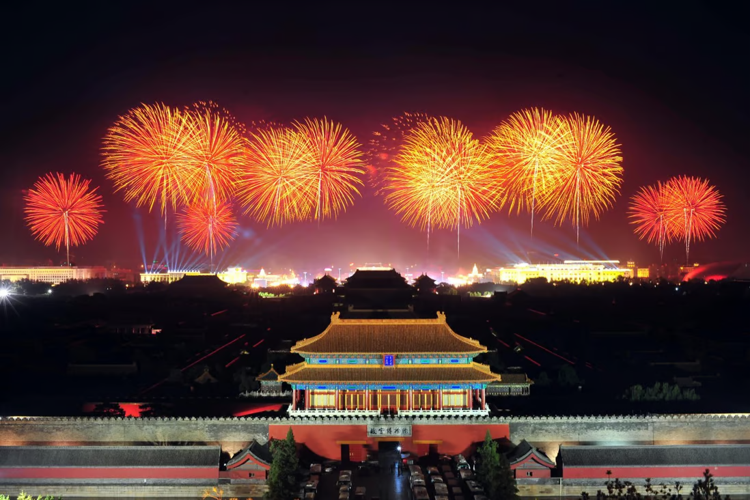
Vocabulary
Firecracker: a usually paper cylinder containing an explosive and a fuse and set off to make a noise
Image: Year of the Rabbit Spring Festival firework show (Associated Press)
Image: Lunar New Year fireworks in Tiananmen Square, Beijing China (AFP)

Slide 21
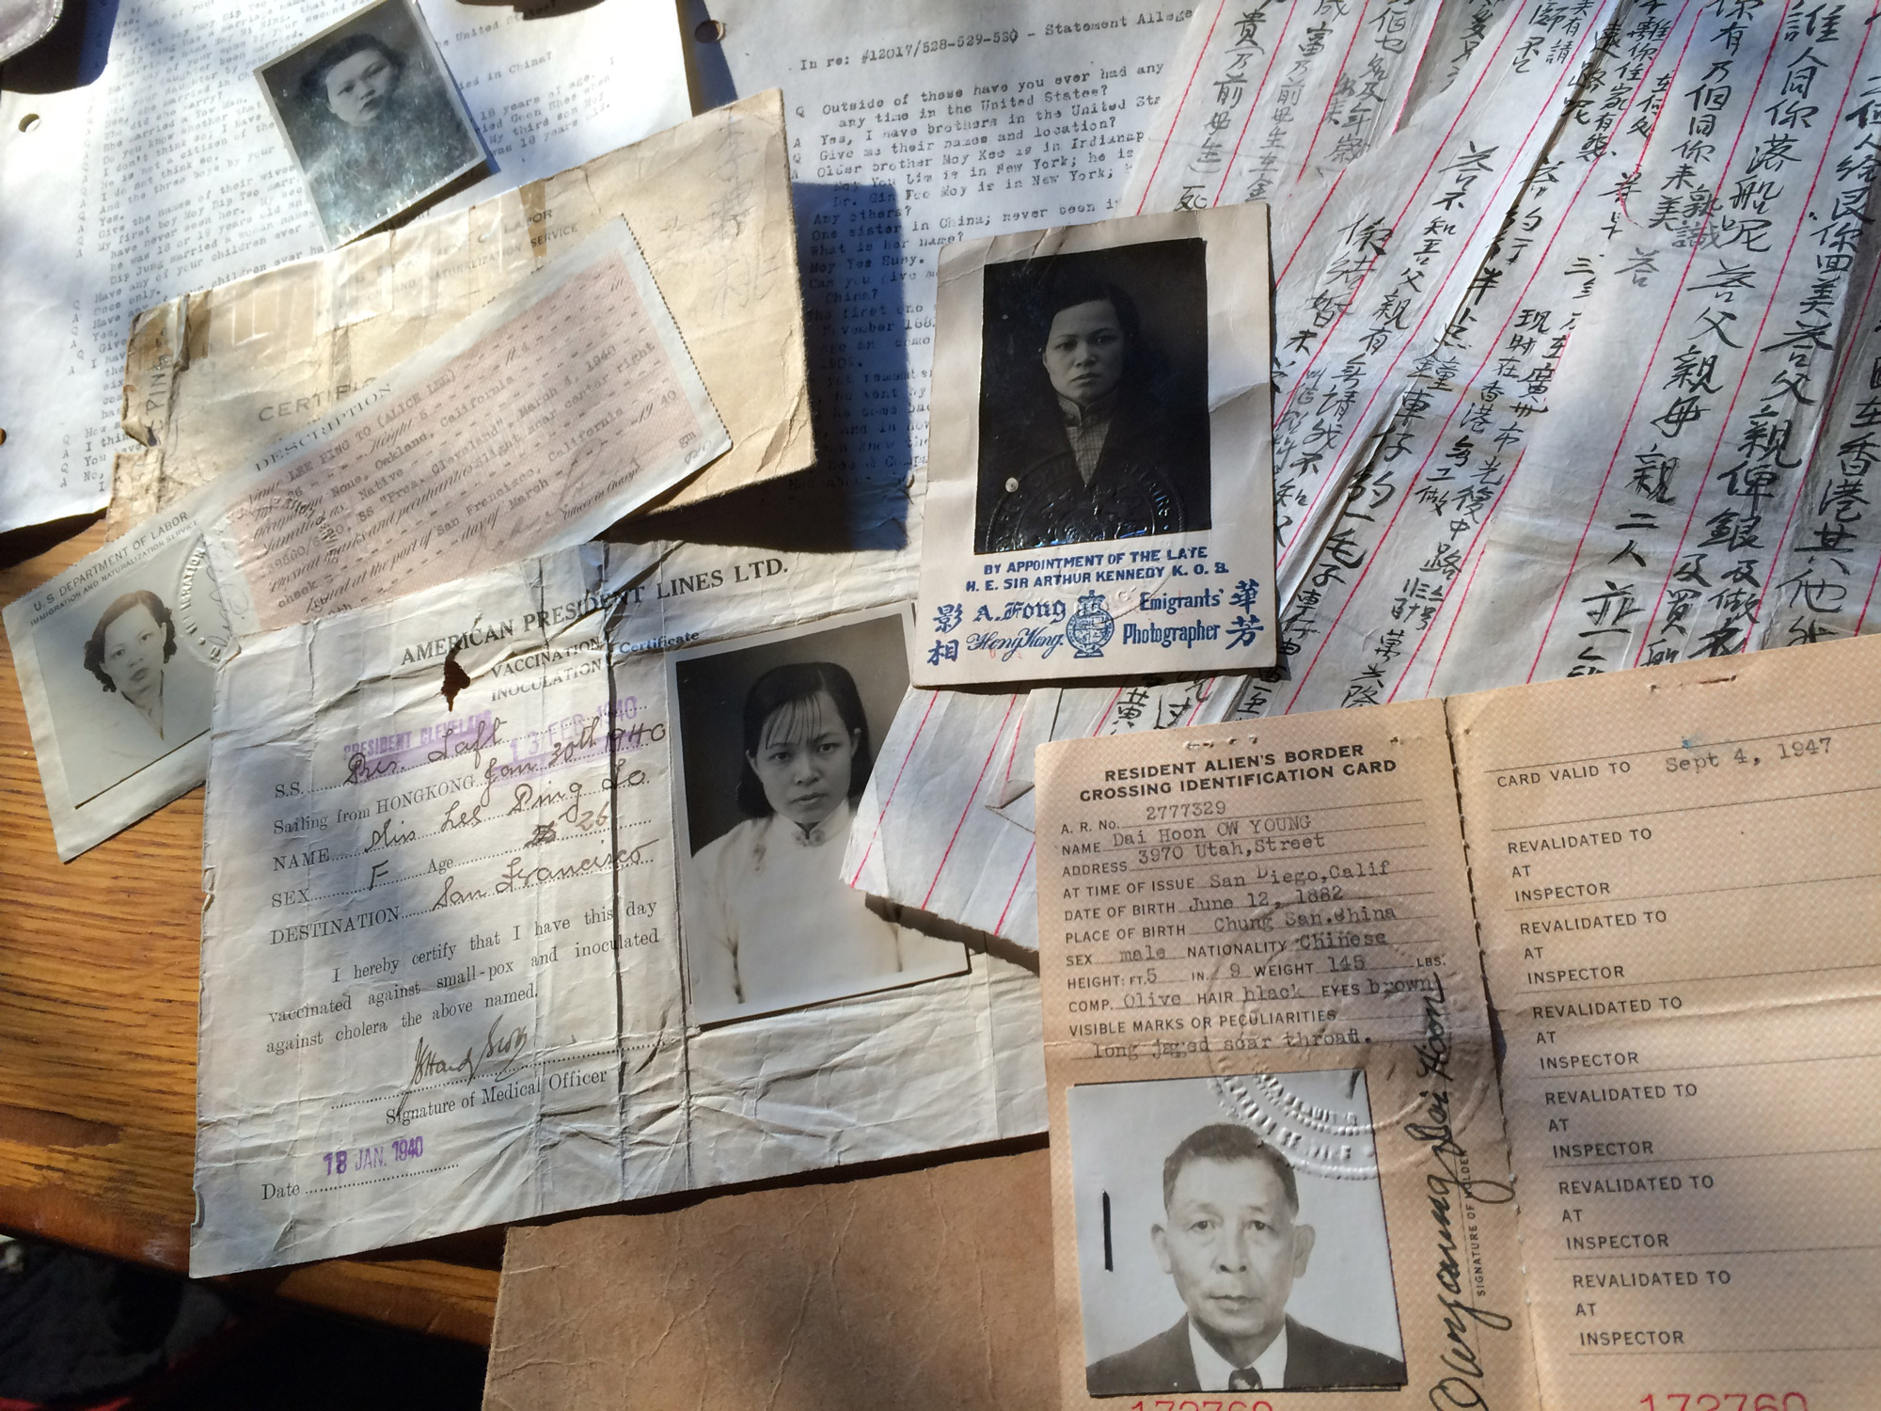
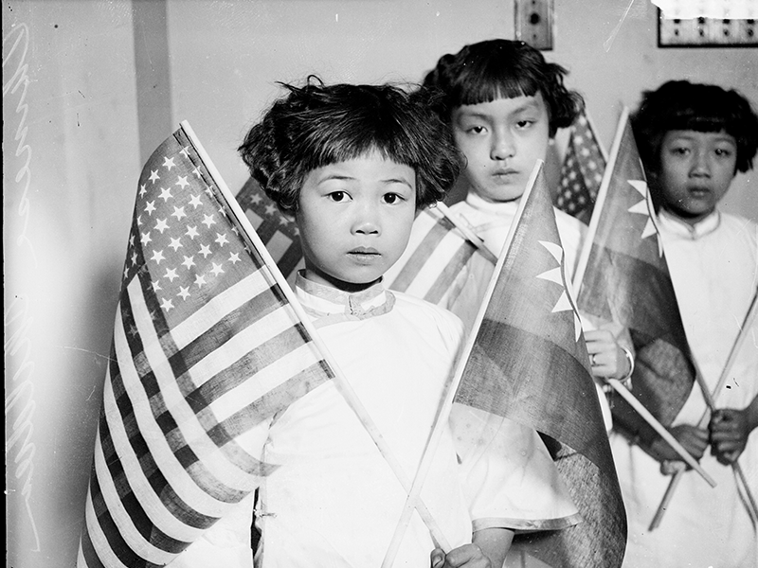
Vocabulary
Immigrant: a person who comes to a country to stay there permanently
Image: Border identification documents for entry into U.S. at Angel Island (Robin Espinola)
Image: Group portrait of Chinese children (Chicago History Museum/Getty Images)

Slide 22
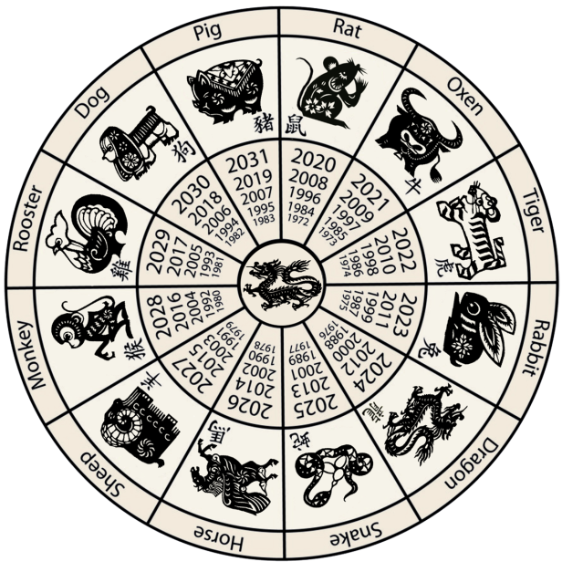
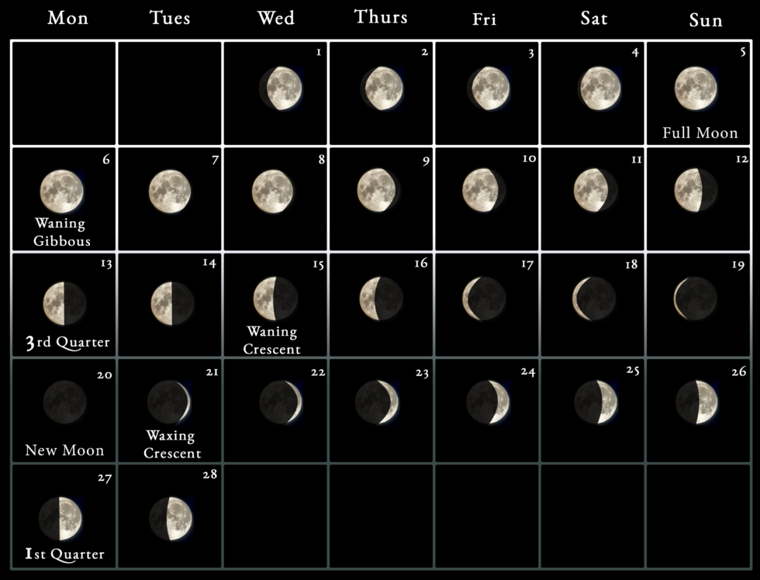
Vocabulary
Lunar calendar: a dating system based on the moon cycle
Image: Chinese Zodiac (wikimedia)
Image: 2023 moon phases (vectorstock.com)

Slide 23
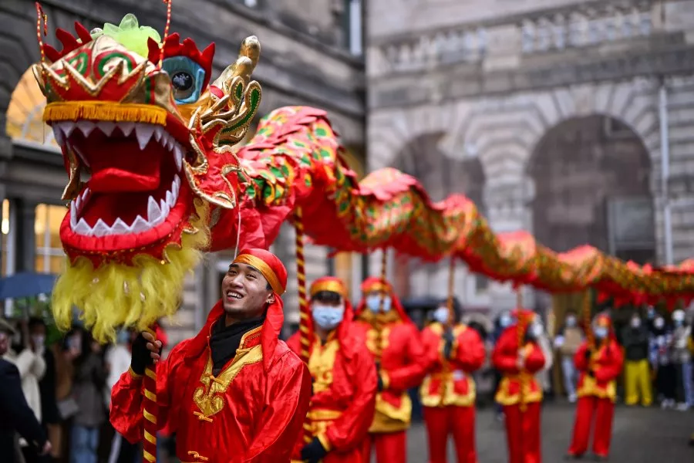
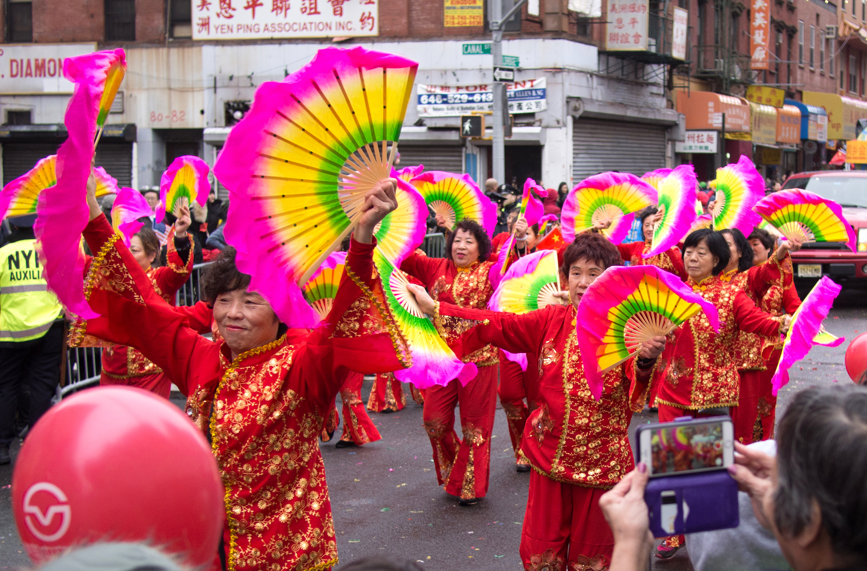
Vocabulary
Parade: a public procession usually to mark a holiday or event
Image: CNY Festival in Edinburgh, Scotland (Jeff J Mitchell/Getty Images)
Image: CNYC Lunar New Year Parade (wikimedia)

Slide 24
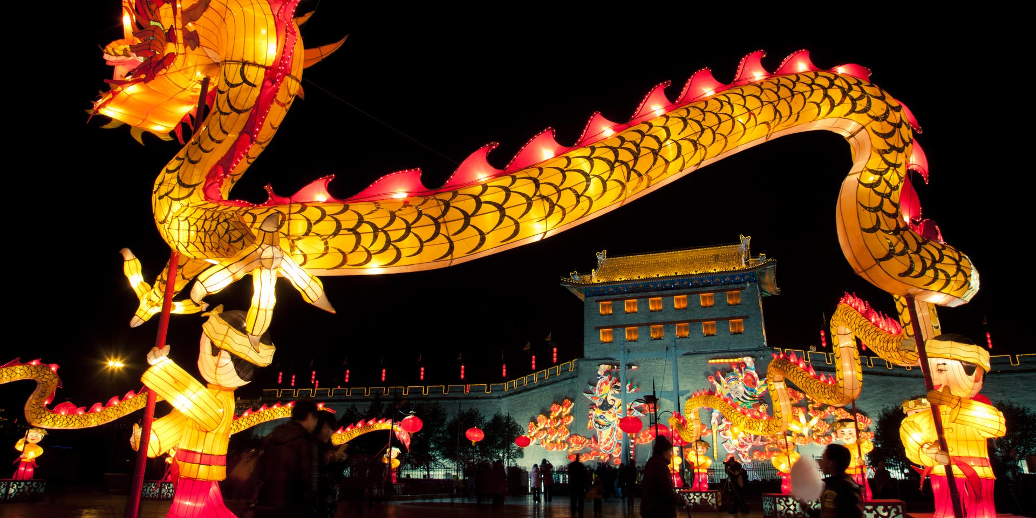
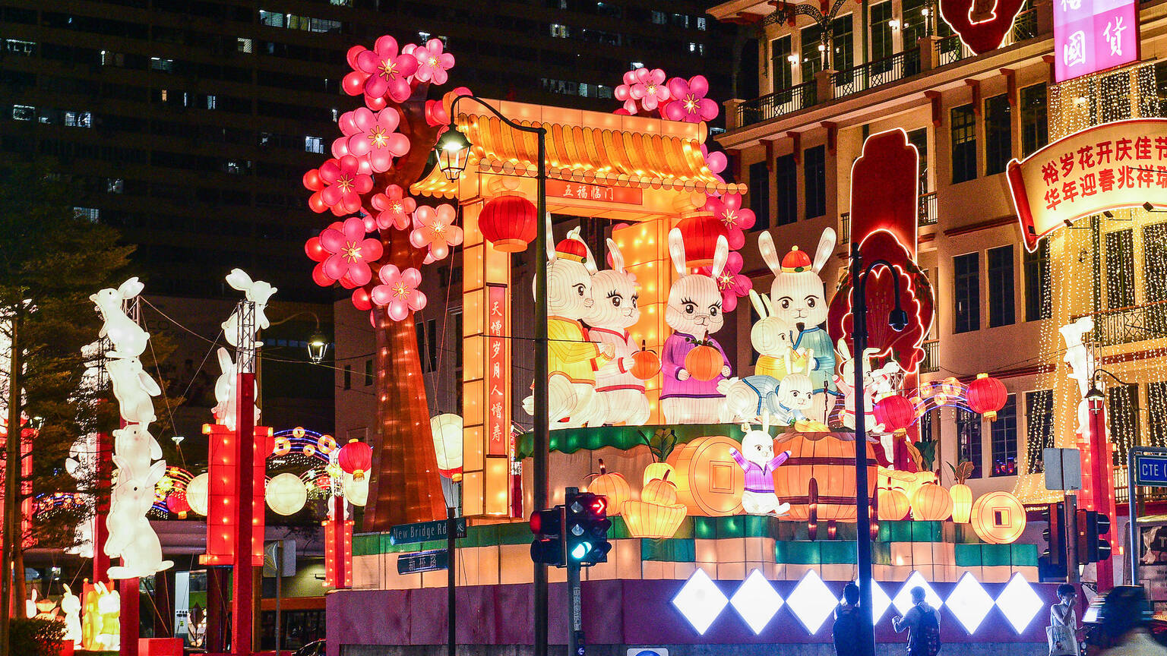
Vocabulary
Public: open to general view
Image: Lunar New Year display (Eastimages/Getty Images)
Image: Year of the Rabbit display in Singapore (Singapore Chinese Cultural Centre)

Slide 25
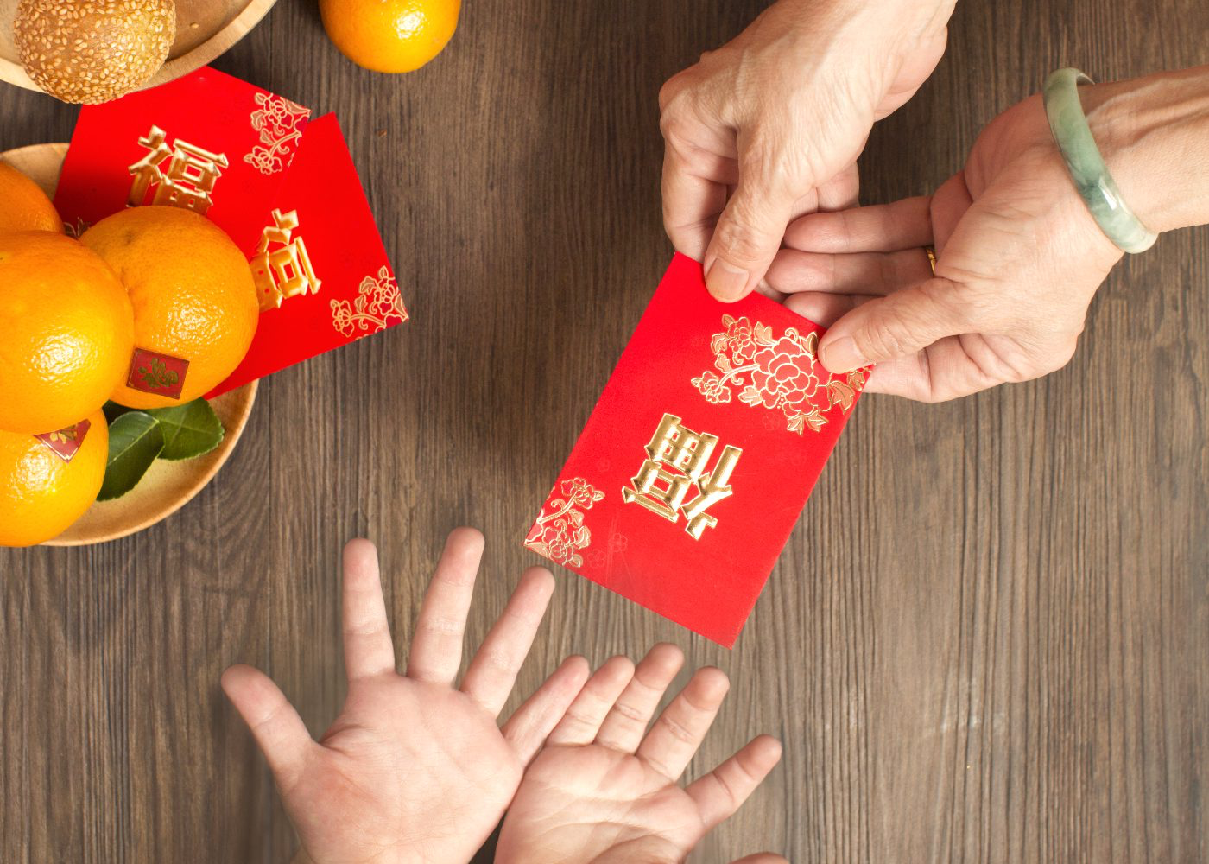
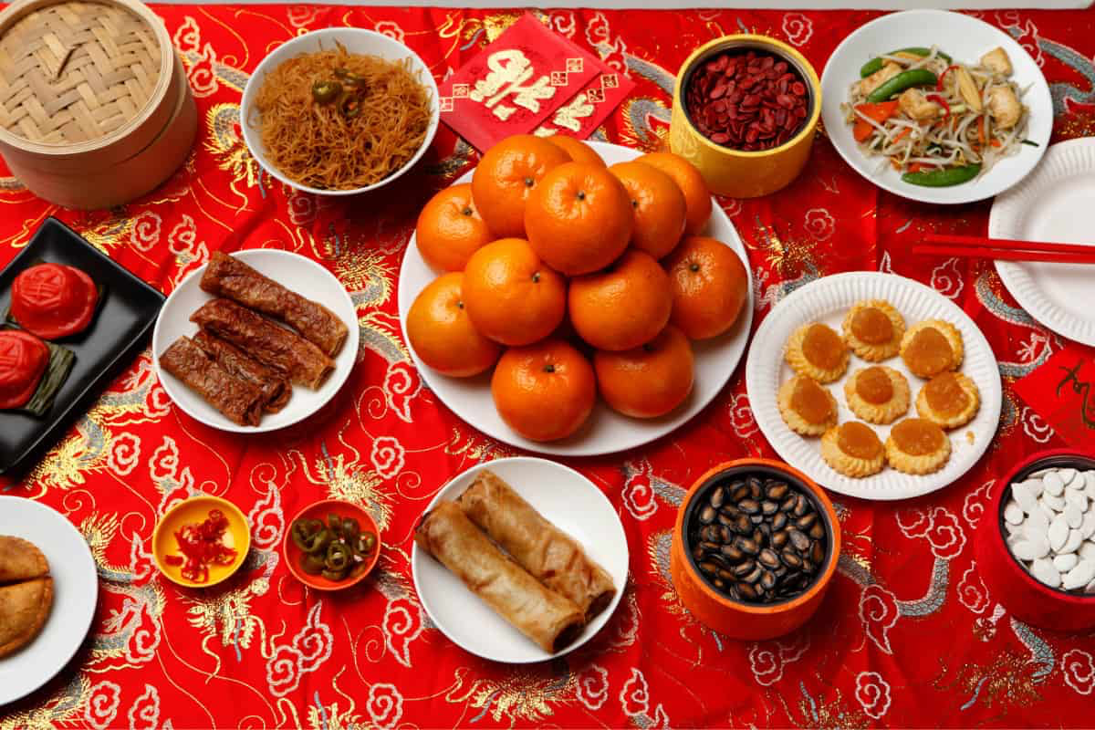
Vocabulary
Tradition: the handing down of information, beliefs, or customs
Image: Lunar New Year red envelopes (Eastimages/Getty Images)
Image: Lunar New Year feast (Eastimages/Getty Images)

Slide 26
Discussion Question:
How are Lunar New Year celebrations the same or different from other New Year celebrations in the United States?
Notes:
Suggested time: 15 minutes

Slide 27
Discussion Question:
Why were early New Year celebrations done secretly?
(Why would people have to hide their cultural traditions?)
Notes:
Suggested time: 15 minutes

Slide 28
Discussion Question:
Why did the Chinese American community in
San Francisco organize the Lunar New Year festival and parade?
Notes:
Suggested time: 15 minutes

Slide 29
Discussion Question:
How is Lunar New Year celebrated? What are some Lunar New Year traditions?
Notes:
Suggested time: 15 minutes

Slide 30
Discussion Question:
How have Lunar New Year celebrations changed over time?
Notes:
Suggested time: 15 minutes

Slide 31
Intro Activity
Notes:
Suggested time: 20 minutes

Slide 32
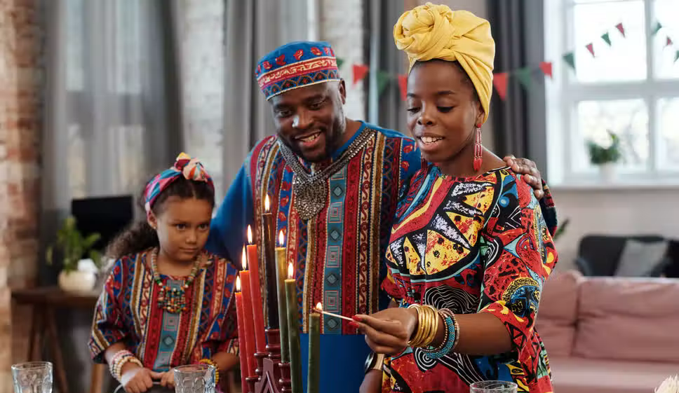
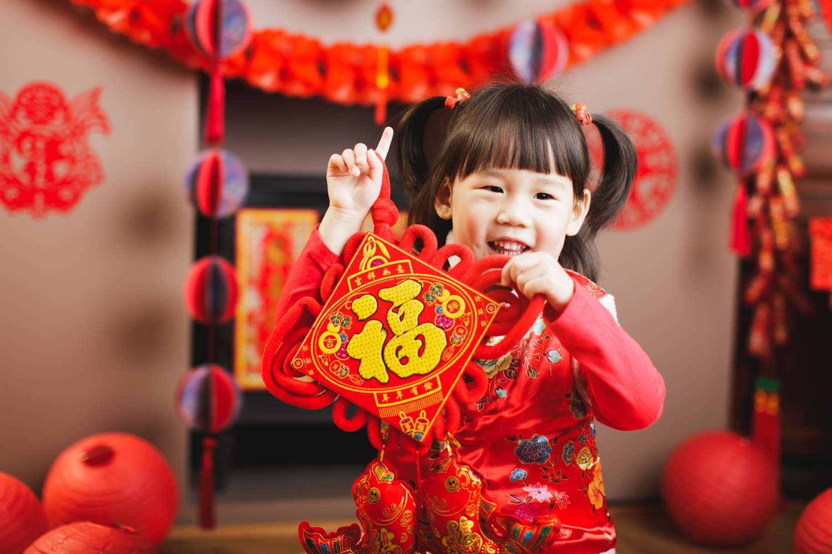
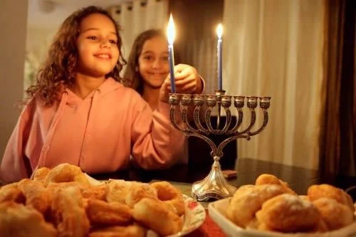
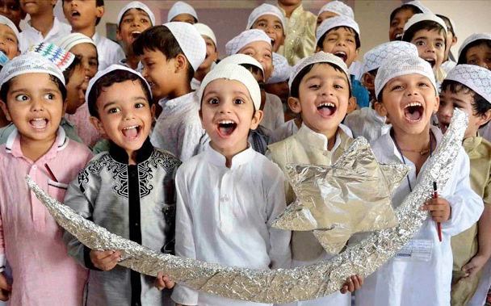
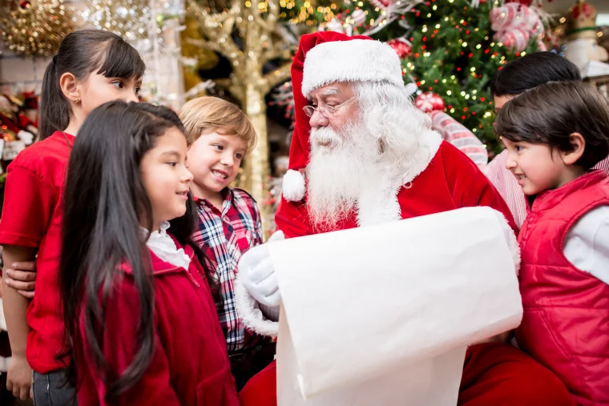
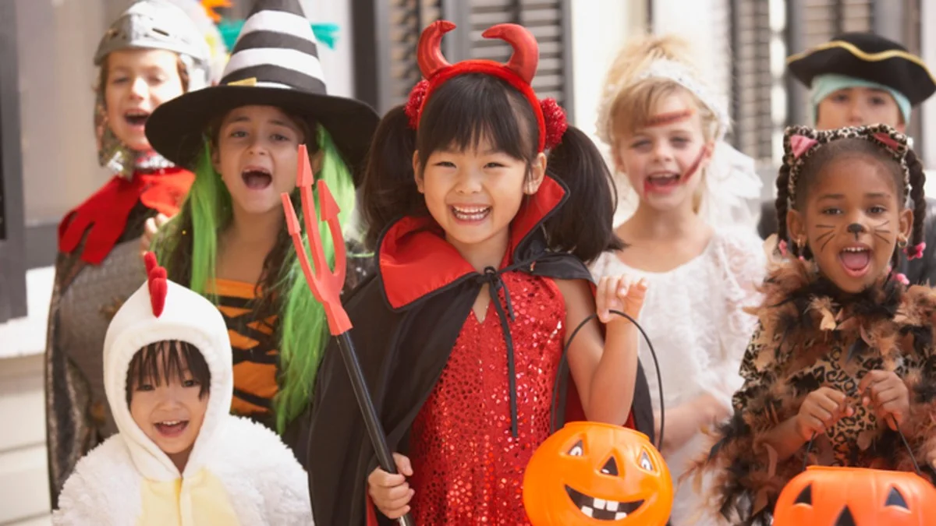
Introduction Activity
Draw a picture of your
favorite holiday.
Finish this sentence:
“My favorite holiday is _____.
I love it because _____.”
Notes:
ACTIVITY 1:
Have students draw a picture of their favorite holiday and have them finish this sentence frame: “My favorite holiday is _____. I love it because _____.”
Holiday images from left to right: Kwanzaa (Pexels), Lunar New Year (Getty Images), Hanukkah (Chabad.org), Eid al-Fitr (India Today), Christmas (Getty Images), Halloween (NBC Chicago)

Slide 33
Introduction Activity
How does your family celebrate the New Year?
Notes:
ACTIVITY 1:
Tell students that celebrating the New Year is a popular tradition. Ask students, “How does your family celebrate the New Year?” Give students time to share out loud. Record their comments on chart paper.

Slide 34
Introduction Activity
What do you know about Lunar New Year or Chinese New Year?
Notes:
ACTIVITY 1:
Ask students, “Have you heard about the Lunar New Year or Chinese New Year?” Have students share out loud what they know about it.

Slide 35

Notes:
ACTIVITY 1:
Video: “Bet You Didn’t Know: Chinese New Year”
Link: https://www.youtube.com/watch?v=asluM20g6rk
Show students the video entitled, “Bet You Didn’t Know: Chinese New Year.” Have students summarize what they learned from the video.

Slide 36
Discussion Question:
Are there other cultures that celebrate Lunar New Year?

Slide 37
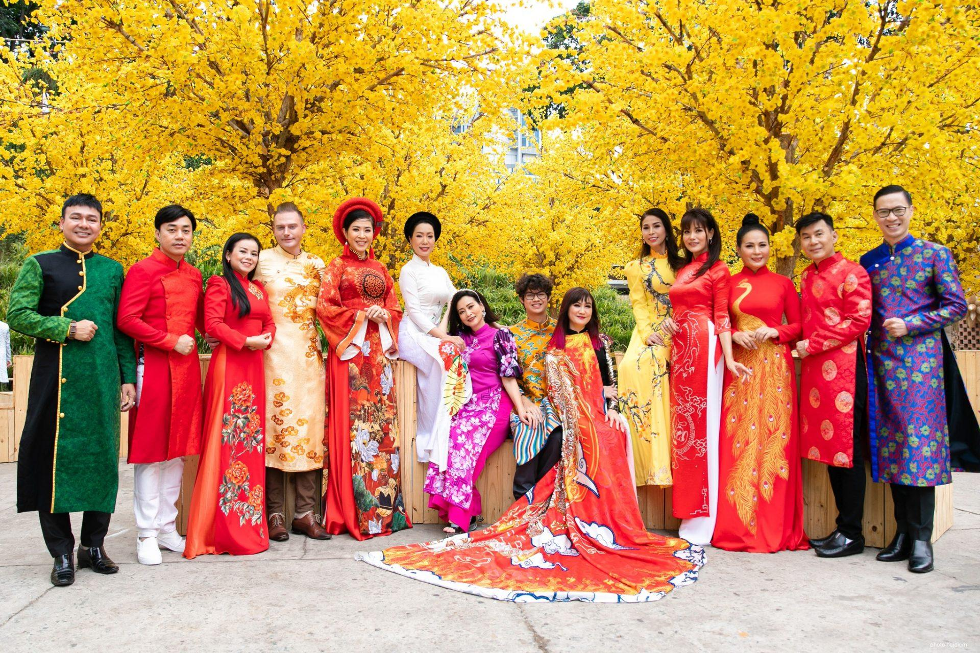
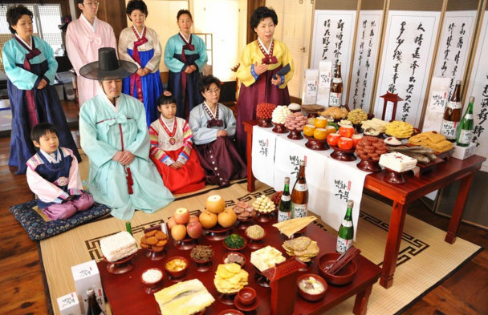

Introduction Activity
Tet (Vietnamese New Year)
Seollal (Korean New Year)
Malaysian New Year
Image: Women and men in traditional aoi dai (shuttersock.com)
Image: Women and men in traditional aoi dai (shuttersock.com)
Image: Tossing of the prosperity salad (Bernama)
Notes:
ACTIVITY 1:
Tell students that Chinese New Year is specific to how the Chinese celebrate Lunar New Year. Explain that the Lunar New Year is celebrated by several countries in Asia and that each country has similar and different traditions.
Tell students that Asian Americans have been celebrating Lunar New Year since the first Chinese immigrants settled in the United States in the 1850s.
Tet (Vietnamese New Year): celebration of the arrival of spring https://vietnamisawesome.com/articles/vietnamese-new-year/
TAP IG post: https://www.instagram.com/p/CZXzwWyJ_lk/?hl=en
Korean New Year
(https://whatsstewin.blogspot.com/2018/02/seoul-experiences-korean-lunar-new-year_16.html)
TAP IG post: https://www.instagram.com/p/CZX0R4kpFQP/?hl=en
Malaysian New Year:
TAP IG post: https://www.instagram.com/p/CZaFv3vpnm_/?hl=en

Slide 38
Instructional Activity
Notes:
Suggested time: 45 minutes

Slide 39


Synthesize Activity
Describe what you notice in each picture
Image: “Procession of the Dragon” (1892)
Image: “Chinamen Celebrating Their New Year’s Day in San Francisco (1870)”
Notes:
ACTIVITY 2:
Show students these two pictures:
● Picture 1: “Procession of the Dragon” (1892): https://commons.wikimedia.org/wiki/File:Procession_of_the_Dragon.jpg
● Picture 2: “Chinamen Celebrating Their New Year’s Day in San Francisco (1870): https://commons.wikimedia.org/wiki/File:Chinamen_Celebrating_Their_New-Year%27s_Day_in_San_Francisco_(Harper%27s_1871-03-25).jpg
Have students describe what they notice in each of the pictures.

Slide 40
Discussion Question:
How was Lunar New Year first celebrated in the United States?
Notes:
ACTIVITY 2
Ask students, “How was Lunar New Year first celebrated in the United States?”

Slide 41
Notes:
ACTIVITY 2
Video: “Chinese New Year Parade 2022 Recap”
Video link: https://www.youtube.com/watch?v=rUfNJ44vhD0
Show students the video entitled, “Chinese New Year Parade 2022 Recap”. Have students describe what they noticed in the video. Ask students, “What was the same and different between the early Lunar New Year celebrations presented in the pictures and the Lunar New Year celebration in the video?”

Slide 42
Discussion Question:
Why do you think traditions change over time?
Notes:
ACTIVITY 2
Ask students, “Why do you think traditions change over time?”

Slide 43
Application Activity
Notes:
ACTIVITY 3: APPLICATION / ENGAGEMENT / INQUIRY ACTIVITY

Slide 44






Application Activity: Option 1
Learn how Lunar New Year is celebrated in your local community.
Image: Resident take part of LNY Festival (Getty Images)
Image: Korean fan dancers for LNY Festival (Getty Images)
Image: Couple taking selfie in front of LNY lanterns (Getty Images)
Image: People praying during CNY (Agung Parameswara/ Getty Images)
Image: Girl reaches for fortune tree (Robertus Pudyanto/ Getty Images)
Image: Vietnamese Buddhist Youth Association (Getty Images)
Notes:
OPTION 1 of ACTIVITY 3
Read aloud Popo’s Lucky Chinese New Year by Virginia Loh-Hagan.
Guide students in researching how Lunar New Year is celebrated in your local community. Show videos and pictures and/or have one of the organizers speak to the students. Have students compare and contrast their local community’s celebration to San Francisco’s Lunar New Year celebration.

Slide 45

Application Activity: Option 2
Draw a picture or create an artifact that represents a part of the first Lunar New Year celebration in San Francisco. Include a caption or tag for your picture or artifact.
Image: Chinese parade with dragon (photographer unknown)
Notes:
OPTION 2 of ACTIVITY 3
Read aloud Popo’s Lucky Chinese New Year by Virginia Loh-Hagan.
Have students draw a picture or create an artifact that represents a part of the first Lunar New Year celebration in San Francisco (i.e., parade, firecrackers, dragon dance, lion dance, drummers, lantern festivals, lucky foods, etc.). Have students include captions or tags for their pictures or artifacts. Organize the pictures or artifacts around the classroom. Have students do a “museum walk.” Have students discuss what they learned.

Slide 46
Writing activity
Notes:
ACTIVITY 4: ASSESSMENT / WRITING ACTIVITY

Slide 47
Writing Activity: Option 1
Create an event flyer about the
first Lunar New Year celebration
in San Francisco, including:
When
Where it took place
What people can expect to see
Image: Chinese New Year in San Francisco, 1875 | University of California
Notes:
OPTION 1
Have students create an event flyer about the first Lunar New Year celebration in San Francisco, including when and where it took place, and what people can expect to see (parade, dragon dance, firecrackers, etc.).

Slide 48

Writing Activity: Option 2
Draw and describe the differences between Lunar New Year celebrations in the United States in the past and present.
Image: Woodcarving of New Year’s in San Francisco’s Chinatown | Harper’s Weekly
Image: Lunar New Year celebration in San Francisco | Santiago Mejia, The Chronicle
Notes:
OPTION 2
Have students draw and describe the differences between Lunar New Year celebrations in the United States in the past and present.

Slide 49


Writing Activity: Option 3
Draw and describe your favorite part of a Lunar New Year celebration
Image: Yusheng Cantonese dish | twomeows/Getty Images
Image: Soaring Phoenix lion dances | Soaring Phoenix Co.
Image: Lucky Money on Lunar New Year | Pexels
Notes:
OPTION 3
Have students draw and describe their favorite part of a Lunar New Year celebration (i.e., parade, dragon dance, firecrackers, etc.).

